Slide 1


Group Number 10
Sahil Dhingra: sahdhin@iu.edu
Pragat Wagle: pwagle@iupui.edu
Mark Green: margree@iu.edu
Kunal Singh: singhku@iu.edu
HOME CREDIT DEFAULT RISK PREDICTION

Slide 2
Description of the PROJECT
HOME CREDIT SET UP A COMPETITION ON KAGGLE TO USE MACHINE LEARNING TO Ensure CLIENTS CAPABLE OF LOAN REPAYMENT ARE NOT REJECT LOANS
THIS PROJECT AIMS TO IMPROVE FINANCIAL INCLUSION BY INCLUDING TELCO AND TRANSACTIONAL DATA TO PREDICT CLIENT REPAYMENT ABLITY

Slide 3
THE FOUR P’s: Past, Present, Next Phase Plan, and Problems
PAST PHASE 1 Tasks
Up Until now we have completed Data Descriptions, Approaches to the Evaluation of Algorithm and Metrics, Designing a BaseLine Pipeline to use for Model Evaluation with Logistic Regression, and a Conclusion and Result analysis on our initial data with no very little transformations and EDA.
PAST PHASE 2 Tasks
Phase 2 Introduced more EDA and Roll up of the Data to Create our Initial transformed Train Data to improve our model. This EDA was performed on all data and the previous baseline model and experiments were performed on this newly transformed data. The goal was to improve our accuracy and test measures. Our approach was good and with experience it will continue to improve.
PAST PHASE 3 Tasks
The next phase we will be perform more specific features transformations and more selective features selections. Introduce other measures for selection features and introduce more processes to our existing pipelines.
Problems
Size of dataset and Visual Eda
Need to Continue to improve our feature selection process beyond correlation and collinearity.

Slide 4
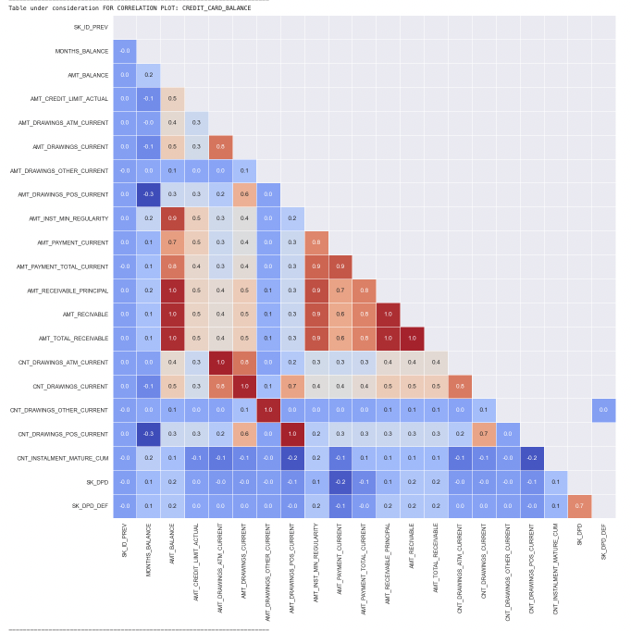
Examples OF VISUAL EDA : A correlation Chart
Below is an example of A correlation CHART for One of the Tables we used Credit Card Balance
Correlation is a statistical measure that expresses the extent to which two variables are linearly related (meaning they change together at a constant rate)
High degree: If the coefficient value lies between ± 0.50 and ± 1, then it is said to be a strong correlation. Moderate degree: If the value lies between ± 0.30 and ± 0.49, then it is said to be a medium correlation. Low degree: When the value lies below + . 29, then it is said to be a small correlation.

Slide 5
Examples OF VISUAL EDA : HistoGram, Boxplot, and Density
Below is an example of Numerical analysis done on the table PREVIOUS_APPLICATION. It consists of a Histogram, BoxPlot, and density
a diagram consisting of rectangles whose area is proportional to the frequency of a variable and whose width is equal to the class interval.
It is often used to illustrate the major features of the distribution of the data in a convenient form.
A boxplot is a standardized way of displaying the distribution of data based on a five number summary
It can tell you about your outliers and what their values are. One of the Tables we used Credit Card Balance
A density plot is a representation of the distribution of a numeric variable.
Allowing for smoother distributions by smoothing out the noise.

Slide 6
OVERVIEW OF THE MODELING PIPELINES THAT WERE EXPLORED
Below is picture of the Code used for our Pipeline
A Numerical Pipeline was created with imputer, to replace missing values with median and standard Scala to remove the mean and scales each feature/variable to unit variance.
A Categorical PipeLine also consisted of the IMputer and then OHE to to perform “binarization” of the categories to each other and include it as a feature to train the model.
They were both combined into a data pipeline and logistic regression performed using GridSearchCv

Slide 7
Results and Discussion of the Results
Below is picture of the results obtained using that previous explained pipeline
Initially in phase one before all of our transformations and roll ups we achieved these accuracy measures
PHASE 1
PHASE 2(NEED TO UPDATE THIS)
Below is picture of the results obtained using Our TRAIN FROM PHASE 2 ___________________
Initially in phase one before all of our transformations and roll ups we achieved these accuracy measures _______
EDA improved our accuracy as we rolled up data and aggregated them by ["min", "max", "count", "sum", "median", "mean", “var”]. Also with OHE, Imputer, transformations, removAL of columns if certain ratio of them were null, And Specific Calculations our overall accuracy improved.

Slide 8
Conclusion from Phase 2 and Next Steps
The Majority of phase 2 was dedicated to rolling up the data and EDA by aggregating based off ["min", "max", "count", "sum", "median", "mean", “var”].
Correlations were determined and highest correlation’s to the target variable and to other attributes in the table were kept
Our overall Test accuracy improved by and Test AUC by ___________________
This showed how important it is to roll up and perform EDA and transformations as it has improved the accuracy of the model
With future Feature Engineering we hope to continue to improve the accuracy of the model.

